Slide 1
Comparative Analysis of CNN and Vision Transformer Models
Image Classification with CIFAR-10
Team Members: Vaishnavi N
Praveen Angolkar
Priti Waghmare
Nikhil Hosamani
Subham Prakash Swain

Slide 2
Objective
Explore and identify at least 5 CNN and Vision Transformer architectures/models commonly used for image classification tasks.
Understand these architectures by reviewing literature, research papers, and related materials.
Conduct a comparative analysis using the CIFAR-10 dataset, evaluating model performance, efficiency, and resource utilization.
Provide insights into designing and training deep learning models for image classification, highlighting their strengths and weaknesses to determine the most effective architecture for this task.

Slide 3
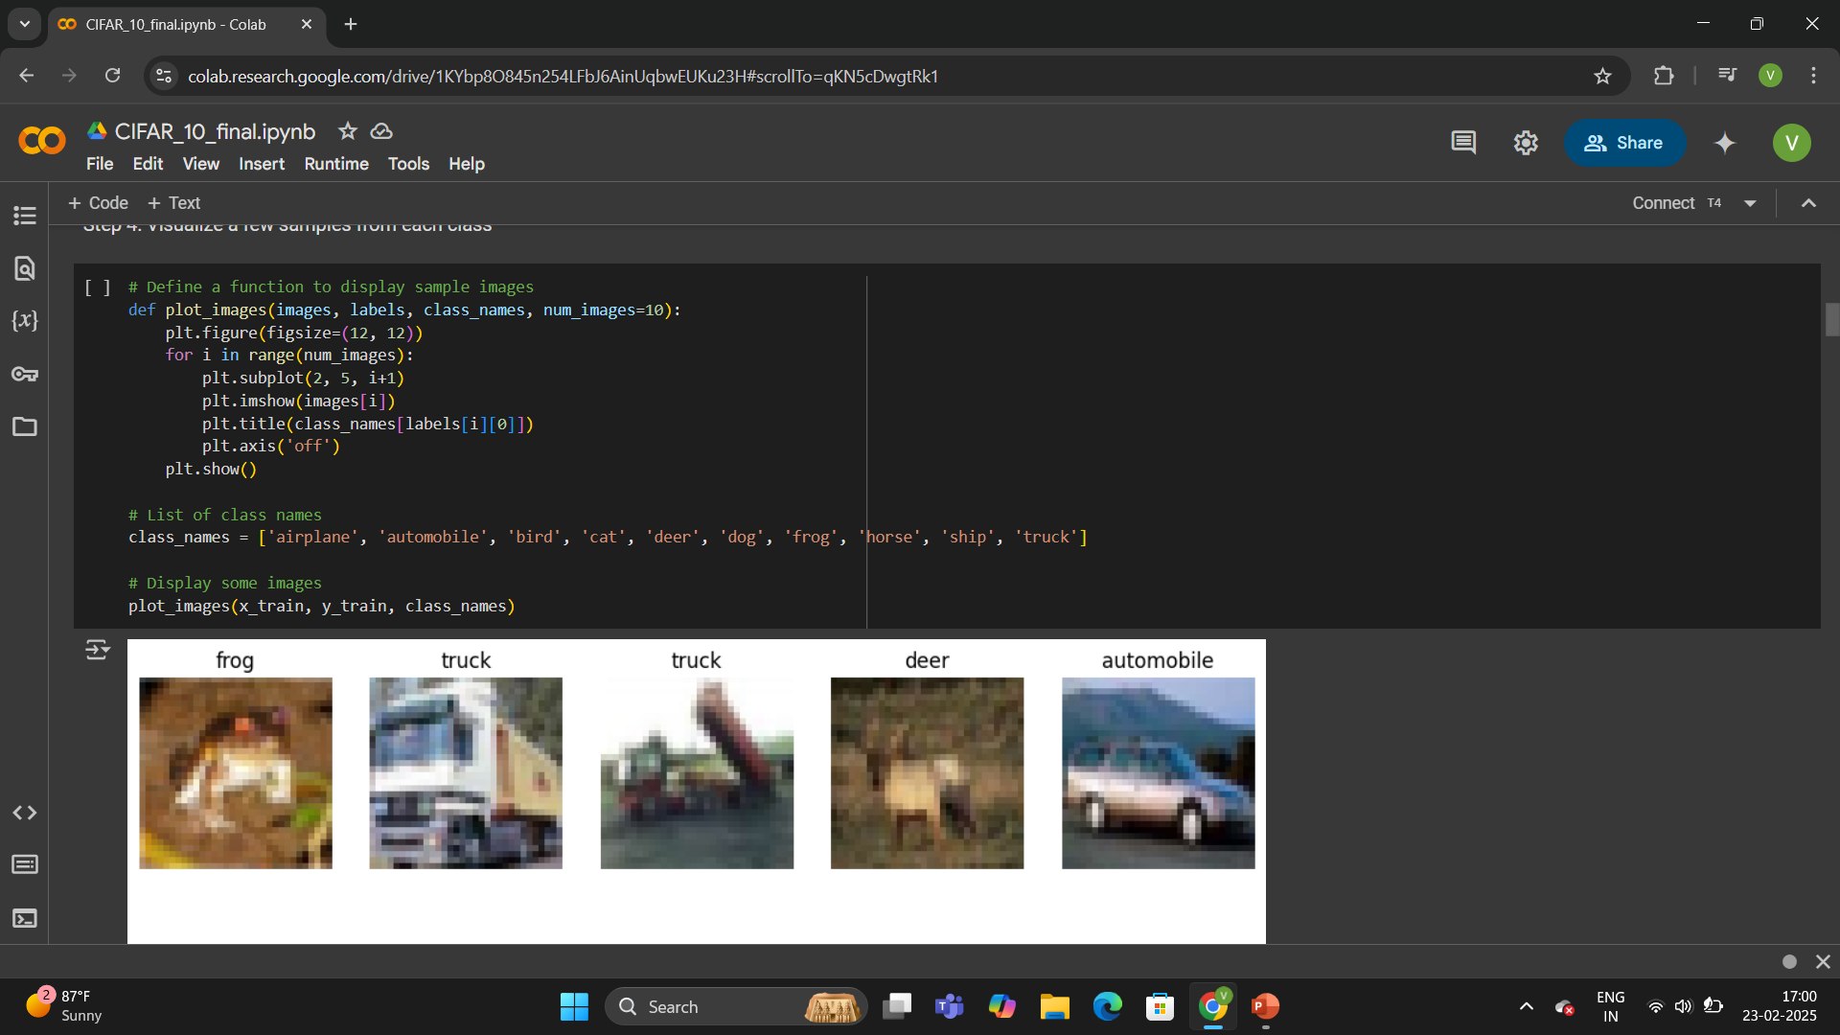
Datasets Used
A dataset of 60,000 32x32 color images in 10 classes, with 6,000 images per class.
50,000 training images and 10,000 test images.
Widely used for image classification tasks and benchmarking machine learning models.
Class Names:
List the 10 classes (airplane, automobile, bird, cat, deer, dog, frog, horse, ship, truck).

Slide 4
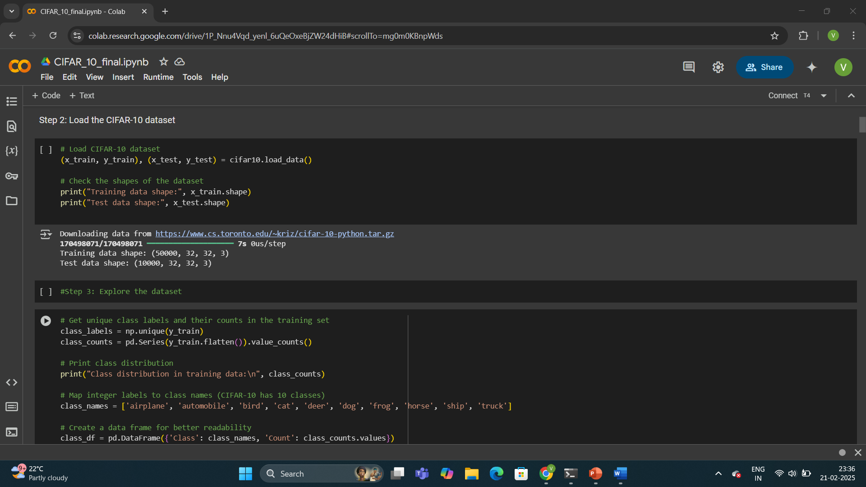
Data Exploration and Preprocessing
Data Loading:
Mention loading the CIFAR-10 dataset using tf.keras.datasets.cifar10.load_data().
Data Visualization:
Include a few sample images from each class (using plot_images function from your code).
Show the distribution of labels in the training dataset (using sns.countplot).
Data Preprocessing:
Normalize pixel values to the range [0, 1].
One-hot encode the labels (if used).

Slide 5
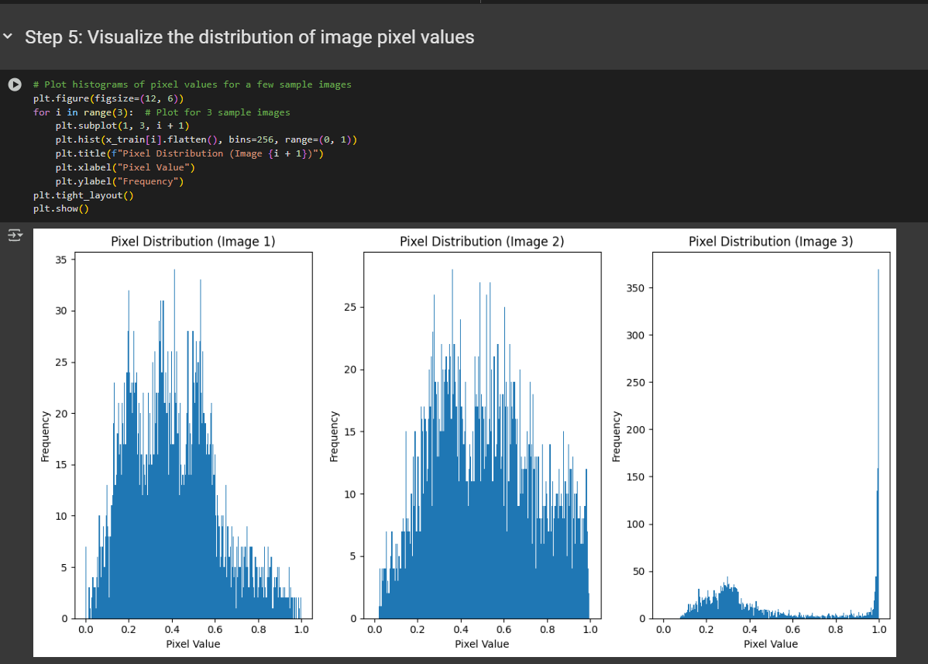
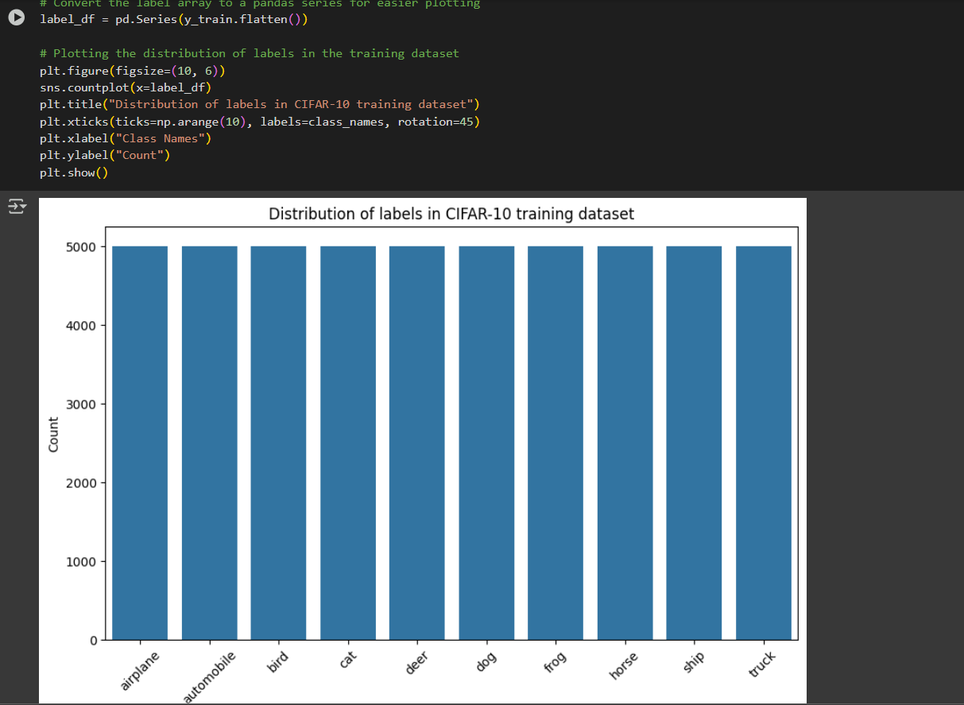

Slide 6
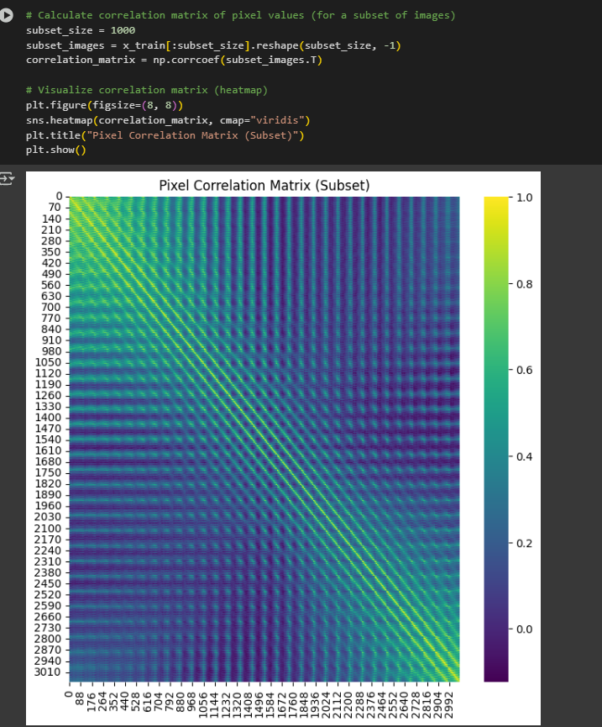
Pixel Correlation Matrix

Slide 7
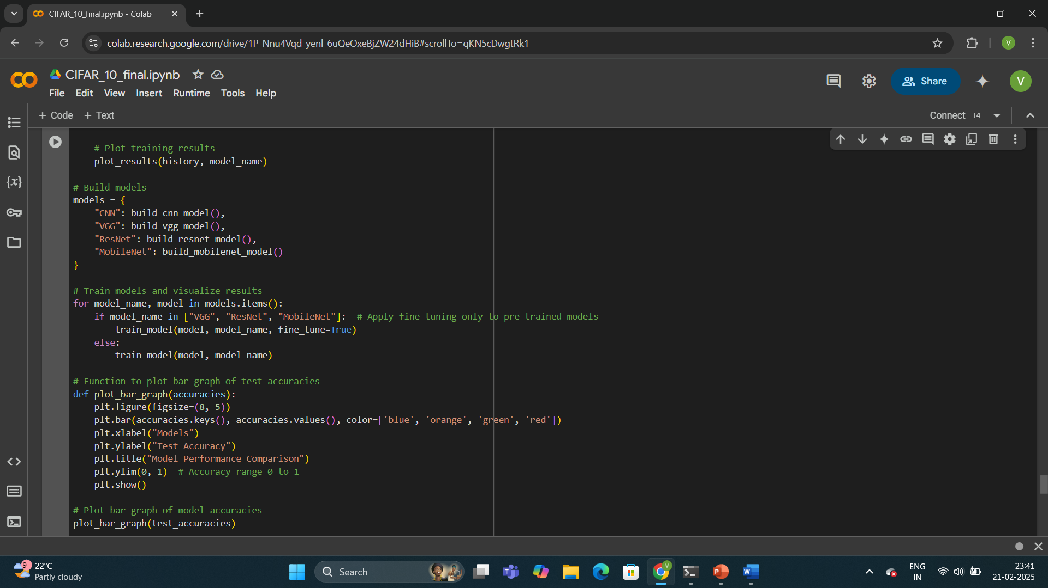
Models Implemented
CNN Models: AlexNet, VGG, ResNet, MobileNet
Vision Transformer (ViT)
Each model trained using optimized hyperparameters for best performance.

Slide 8
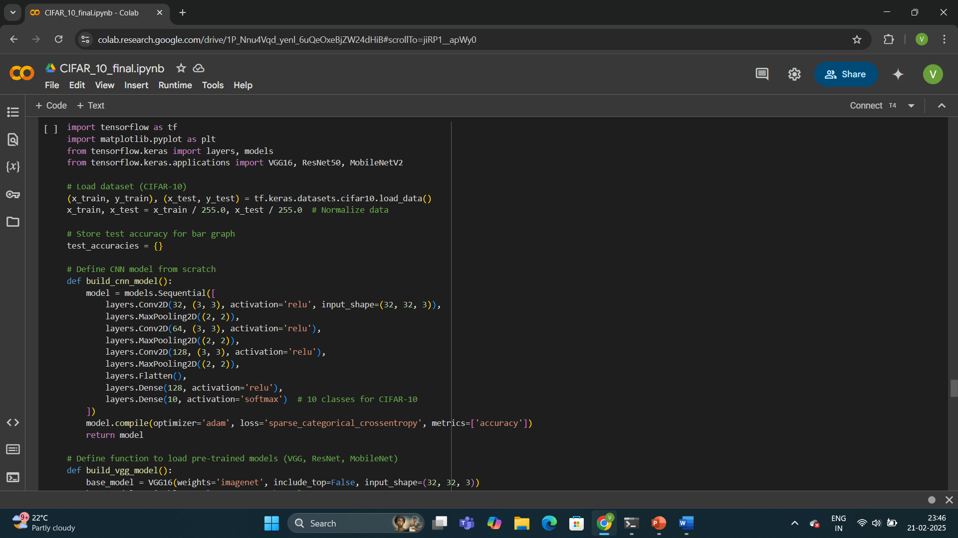
Implementation Approach
Conducted literature review of CNN and Vision Transformer architectures.
Downloaded and preprocessed CIFAR-10 dataset.
Trained models using TensorFlow/PyTorch.
Evaluated models using accuracy, training time, and resource usage.

Slide 9
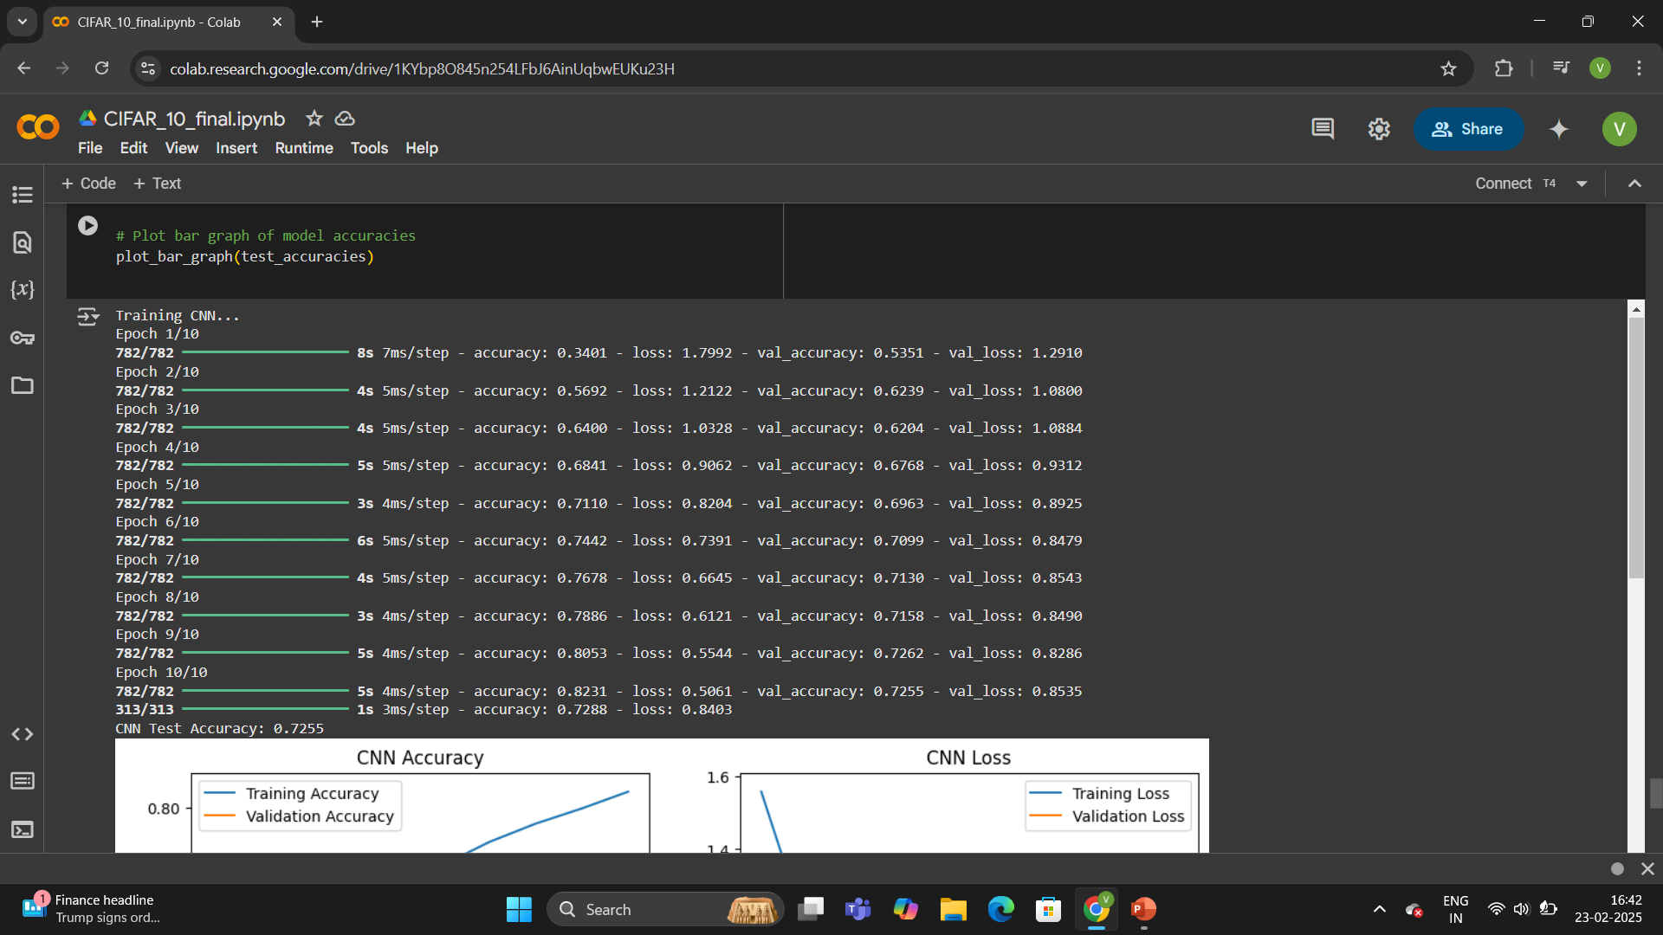
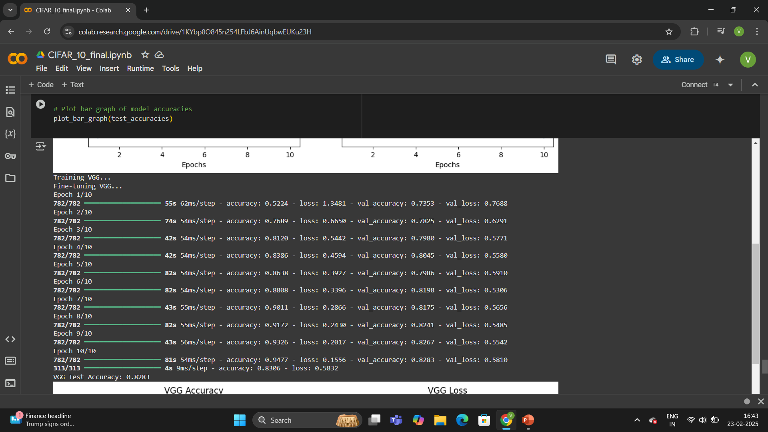
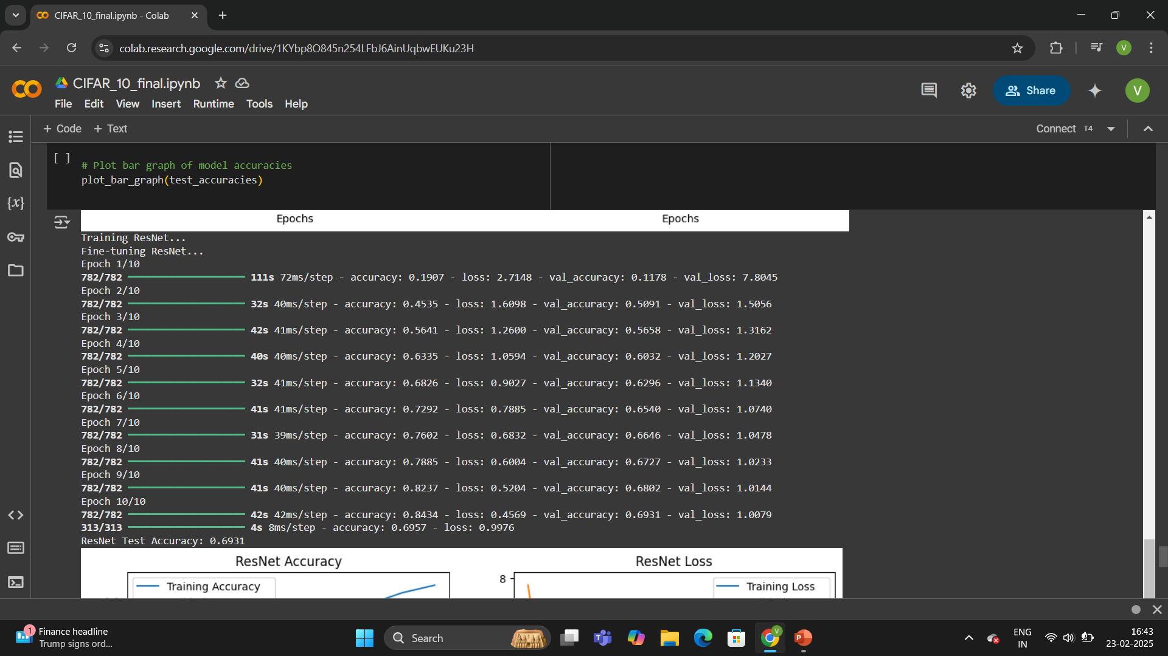
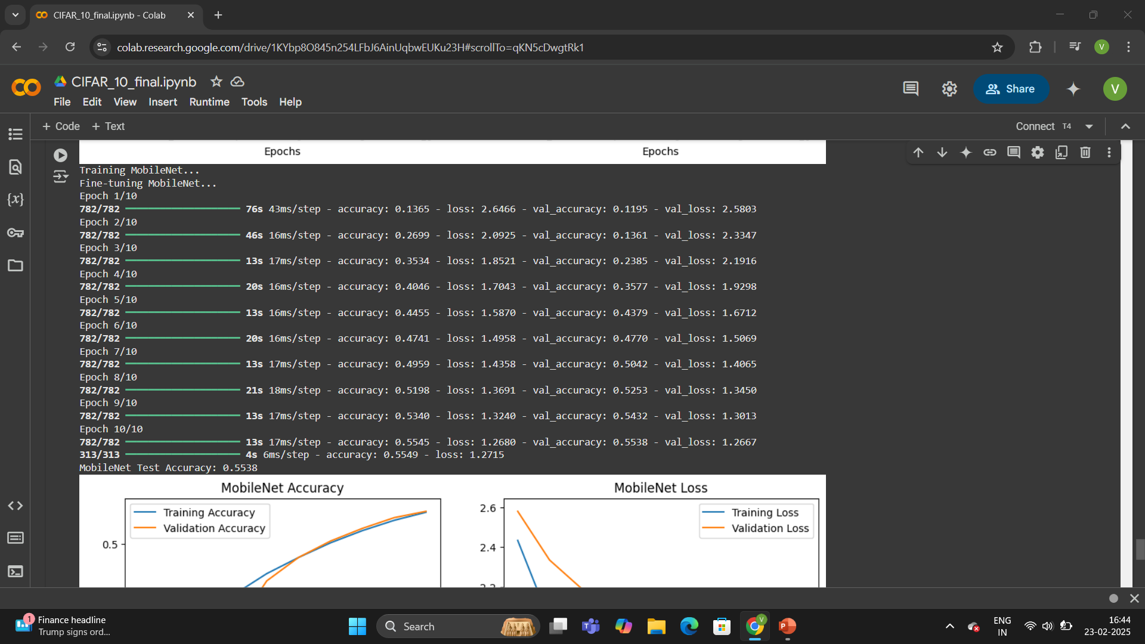

Slide 10
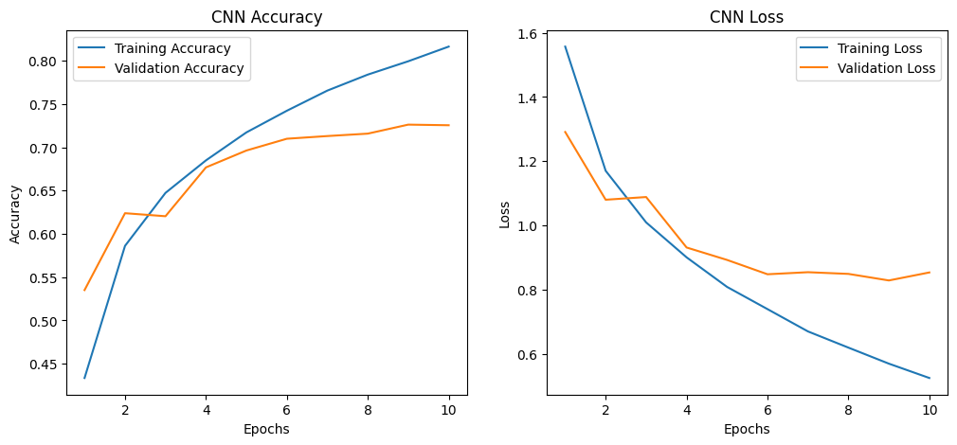
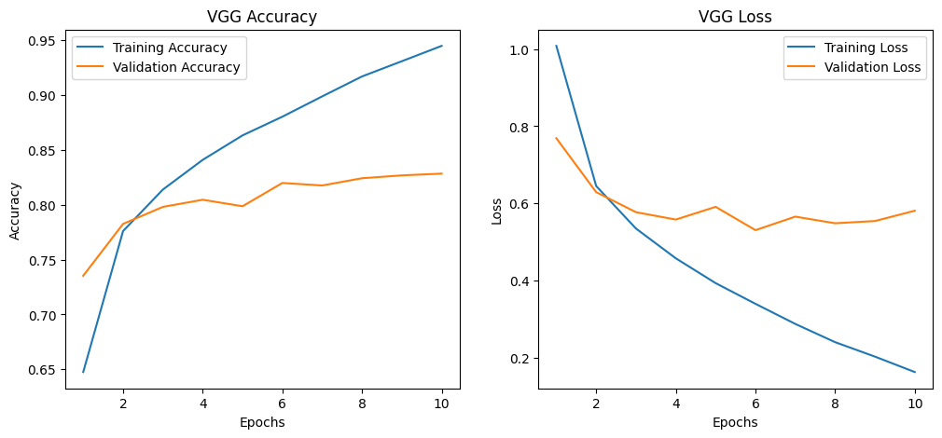
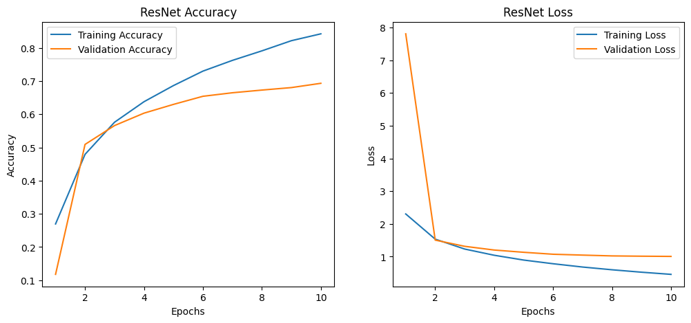
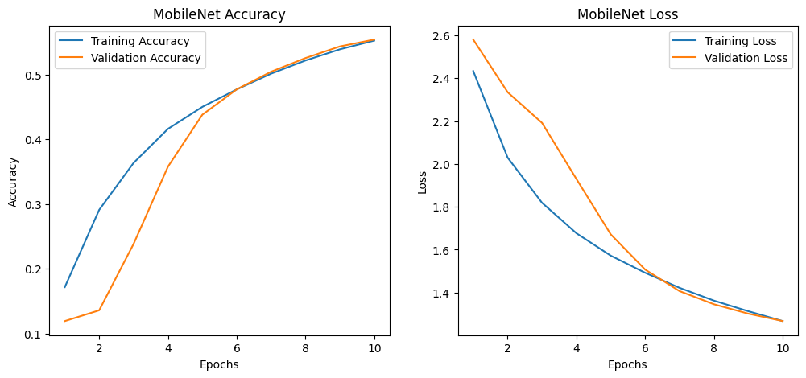

Slide 11
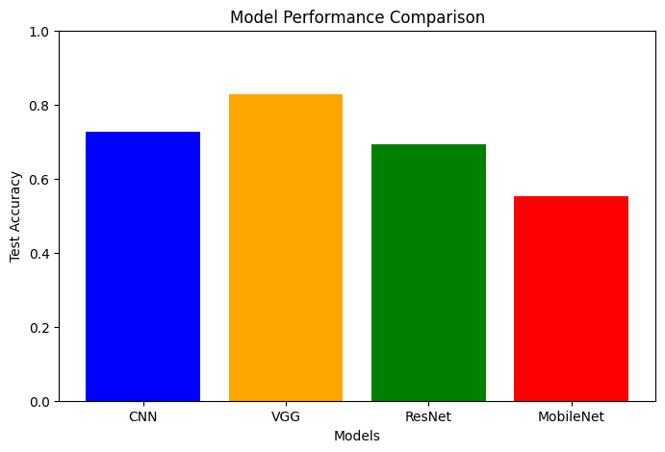
Results & Comparative Analysis
Model Performance Comparison
• AlexNet and VGG: High accuracy, slower inference
• ResNet and MobileNet: Balance of accuracy and speed
• Vision Transformer: Competitive accuracy, but higher resource usage
• Overall, MobileNet and ResNet offered the best trade-off for real-world deployment

